Slide 1

Learn SQL from Scratch
Kriti Jain
06/27/2018

Slide 2
Table of Contents
Get familiar with Warby Parker
What is the Quiz Funnel
A/B Testing with Home Try-On Funnel

Slide 3
1. Quiz Funnel

Slide 4
1. What columns does the table have?
question
user_id
response
SELECT *
FROM survey
LIMIT 10;

Slide 5
2. What is the number of responses for each question?
question | COUNT (DISTINCT user_id)
1. What are you looking for? | 500
2. What's your fit? | 475
3. Which shapes do you like? | 380
4. Which colors do you like? | 361
5. When was your last eye exam? | 270
SELECT question,
COUNT (DISTINCT user_id)
FROM survey
GROUP BY 1;

Slide 6
3. Which question(s) of the quiz have a lower completion rates?
Question 5 and Question 3 have lower completion rates.
For question 3, it talks about the shapes people like, and the reason some of the people did not complete this question could be because they are not really concerned which shape they want their glasses to be.
For question 5, the reason they might not have completed the question could be that they did not have an eye exam previous to this, so they left it blank.
Question | Percentage completing this Question
1. What are you looking for? | 100%
2. What's your fit? | 95%
3. Which shapes do you like? | 80%
4. Which colors do you like? | 95%
5. When was your last eye exam? | 75%

Slide 7
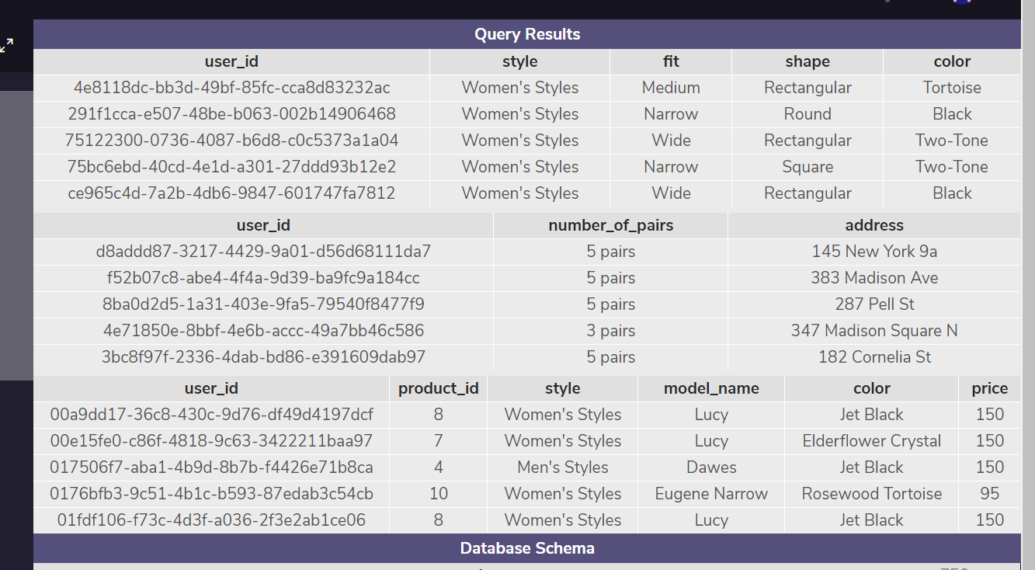
4. What are the column names?
SELECT *
FROM quiz
LIMIT 5;
SELECT *
FROM home_try_on
LIMIT 5;
SELECT *
FROM purchase
LIMIT 5;

Slide 8
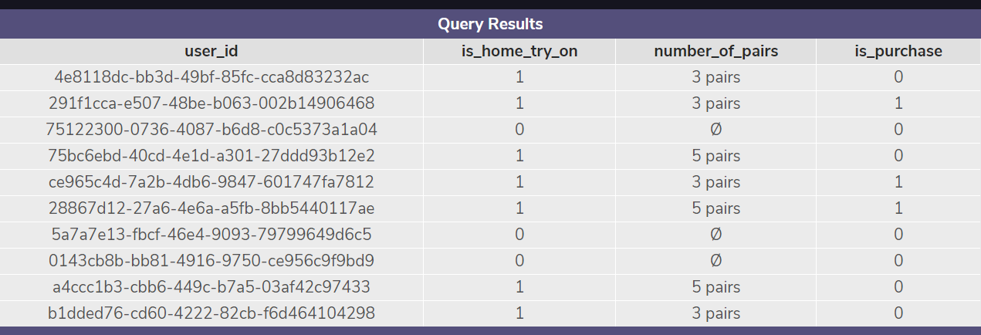
5. Select only the first 10 rows from this table
SELECT DISTINCT q.user_id,
h.user_id IS NOT NULL AS 'is_home_try_on',
h.number_of_pairs,
p.user_id IS NOT NULL AS 'is_purchase'
FROM quiz q
LEFT JOIN home_try_on h
ON q.user_id = h.user_id
LEFT JOIN purchase p
ON p.user_id = q.user_id
LIMIT 10;

